Slide 1
The Pipelined Processor
Dr. Rajib Ranjan Maiti
CSIS, BITS-Pilani, Hyderabad

Slide 2
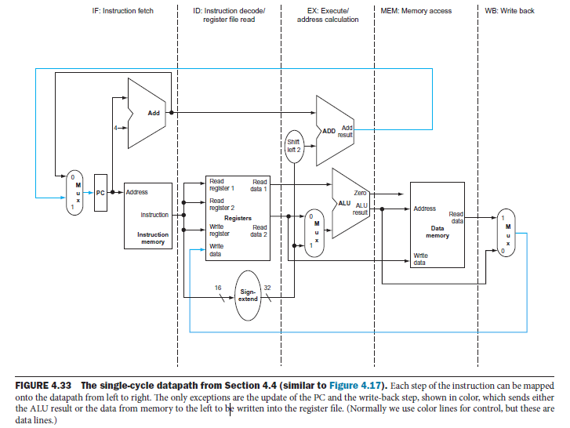
Pipelined Datapath and Control
Thus, we must separate the datapath into five pieces, with each piece named corresponding to a stage of instruction execution:
1. IF: Instruction fetch
2. ID: Instruction decode and register file read
3. EX: Execution or address calculation
4. MEM: Data memory access
5. WB: Write back

Slide 3
Pipelined Datapath and Control
The write-back stage,
places the result back into the register file in the middle of the datapath
The selection of the next value of the PC,
choosing between the incremented PC and the branch address from the MEM stage
Data flowing from right to left,
these reverse data movements influence only later instructions in the pipeline
the first right-to-left flow of data can lead to data hazards and
the second leads to control hazards

Slide 4
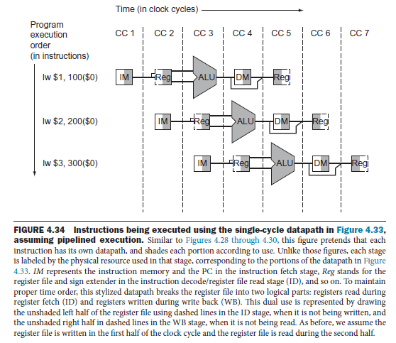
A closure look
three instructions need three datapaths!!!
Instead, we add registers to hold data so that portions of a single datapath can be shared during instruction execution

Slide 5
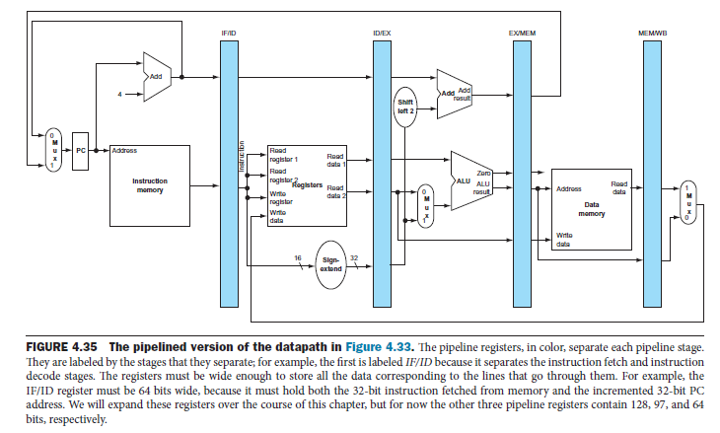
Pipelined Datapath

Slide 6
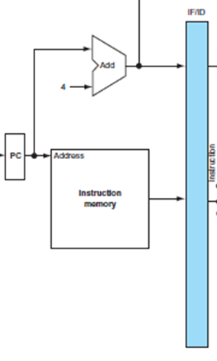
The Components that are active in each of the five stages
For lw instruction
Instruction fetch:
the instruction being read from memory using the address in the PC and then being placed in the IF/ID pipeline register.
The PC address is incremented by 4 and then written back into the PC to be ready for the next clock cycle.
This incremented address is also saved in the IF/ID pipeline register in case it is needed later for an instruction, such as beq.
➔ Thus, IF/ID register is 64 bits long

Slide 7
The Components that are active in each of the five stages
For lw instruction
Instruction decode and register file read:
the instruction portion of the IF/ID pipeline register supplying the 16-bit immediate field, which is sign-extended to 32 bits, and
the register numbers to read the two registers.
All three values (16 bit + 5 bits + 5 bits) are stored in the ID/EX pipeline register,
along with the incremented PC address (32 bits).
We again transfer everything that might be needed by any instruction during a later clock cycle
An MIPS instruction may operate on i) a single source register, ii) two source registers, iii) one source register and a sign-extended 32-bit immediate value, iv) a sign-extended 32-bit immediate value, or v) no operands.
We can either prepare only the required operands for the EX stage based on the opcode or prepare all the operands that might be required for any opcode. → 2x32 (reg contents) + 1x32(sign ext) + 32 (instruction) + 32 (PC+4) = 5x32 bits in ID/EX

Slide 8
The Components that are active in each of the five stages
For lw instruction
Execute or address calculation: from the ID/EX pipeline register
Read the content of register 1 and
Read the sign-extended immediate
and adds them using the ALU
That sum is placed in the EX/MEM pipeline register
EX/MEM register: (a 4-byte ALU result or a 4-byte effective data memory address or a 4-byte branch target address) + a 1-bit condition flag + 4-byte instruction + 4-byte (for sw data)

Slide 9
The Components that are active in each of the five stages
For lw instruction
Memory access:
reading the data memory using the address from the EX/MEM pipeline register and
loading the data into the MEM/WB pipeline register
EX/MEM Reg : a single 4-byte field (whatever it represents) + 1-bit field for the condition + a 4-byte field for instruction + a 4-byte for sw data

Slide 10
The Components that are active in each of the five stages
For lw instruction
Write-back:
reading the data from the MEM/WB pipeline register and writing it into the register file
For branch: the branch target and the branch condition to be passed to the IF fetch to determine the new PC
For sw: no result to be passed to any stage
For ld: the 4-byte value is fetched from memory and stored in a field in the MEM/WB register
For ALU: the 4-byte result to be passed to a field in the MEM/WB register
+ a 4-byte field in MEM/WB to hold the instruction

Slide 11
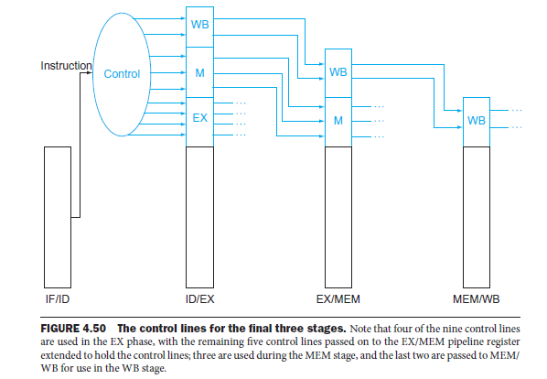
The Components that are active in each of the five stages
IF/ID pipeline register: 8 bytes
ID/EX pipeline register: 20 bytes
EX/MEM pipeline register: 25 bits
MEM/WB pipeline register: 8 bytes

Slide 12
The Components that are active in each of the five stages
For sw instruction
Instruction fetch:
instruction read and placed in the IF/ID pipeline register
Instruction decode and register file read:
IF/ID pipeline register supplies the register numbers for reading values and 16-bit immediate for sign extension
So, three 32-bit values are in ID/EX pipeline register.
Execute and address calculation:
the effective address is placed in the EX/MEM pipeline register
Memory access:
Register data to be stored was read in an earlier stage and stored in ID/EX.
The way data available is placed into the EX/MEM pipeline register
Write-back:
Nothing happens in the write-back stage
An instruction passes through a stage even if there is nothing to do, because later instructions are already progressing at the maximum rate

Slide 13
Key Points in lw and sw instruction
Pass something from an early pipe stage to a later pipe stage
For sw,
pass one of the registers read in the ID stage to the MEM stage
data first placed in the ID/EX pipeline register and then passed to the EX/MEM pipeline register
Each component of the datapath can be used only within a single pipeline stage
Such as instruction memory, register read ports, ALU, data memory, and register write port
Otherwise, structural hazard results
Now we can uncover a bug in the design of the load instruction. Did you see it?
Which register is changed in the final stage of the load? i.e., which instruction supplies the write register number?
The instruction in the IF/ID pipeline register supplies the write register number, yet this instruction occurs considerably after the load instruction!
lw must pass the register number from the ID/EX through EX/MEM to the MEM/WB pipeline register for use in the WB stage

Slide 14
Pipelined Control

Slide 15
Pipelined Control
the PC is written on each clock cycle,
so there is no separate write signal for the PC.
Similarly, no separate write signals for the pipeline registers (IF/ ID, ID/EX, EX/MEM, and MEM/WB)
we need only set the control values during each pipeline stage.
Because each control line is associated with a component active in only a single pipeline stage,
we can divide the control lines into five groups according to the pipeline stage
1. Instruction fetch:
No control signal is required to read instruction memory or to write the PC
2. Instruction decode/register file read:
there are no optional control lines to set
3. Execution/address calculation:
The signals to be set are RegDst, ALUOp, and ALUSrc
The signals select the Result register, the ALU operation, and either Read data 2 or a sign-extended immediate for the ALU
4. Memory access:
The control lines set in this stage are Branch, MemRead, and MemWrite.
The branch equal, load, and store instructions set these signals, respectively.
5. Write-back:
The two control lines are MemtoReg, which decides between sending the ALU result or the memory value to the register file, and Reg-Write, which writes the chosen value.

Slide 16
Implementation of Pipelined Control
setting the nine control lines to these values in each stage for each instruction.
RegDst, ALUOp1, ALUOp0, ALUSrc, Branch, Mem-Read, Mem-Write, Reg-Write, Memto-Reg
The simplest way to do this is to
extend the pipeline registers to include control information
Since the control lines start with the EX stage,
we can create the control information during instruction decode
Since pipelining the datapath leaves the meaning of the control lines unchanged, we can use the same control values

Slide 17
Implementation of Pipelined Control

Slide 18
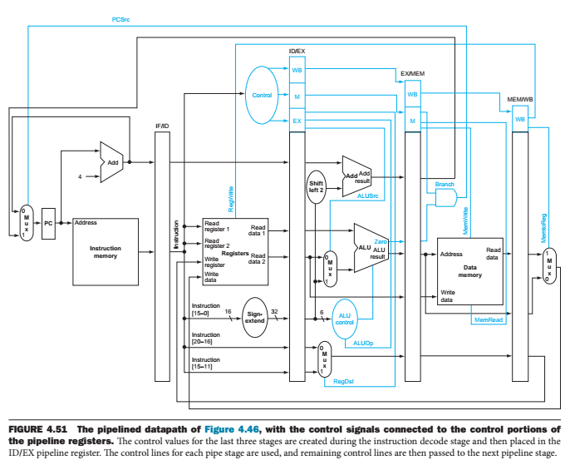
full datapath with the extended pipeline registers and with the control lines connected

Slide 19
Data Hazards: Forwarding versus Stalling

Slide 20
Data hazard
Let’s look at a sequence with many dependences, shown in color:
sub $2, $1,$3 # Register $2 written by sub
and $12,$2,$5 # 1st operand($2) depends on sub
or $13,$6,$2 # 2nd operand($2) depends on sub
add $14,$2,$2 # 1st($2) & 2nd($2) depend on sub
sw $15,100($2) # Base ($2) depends on sub

Slide 21
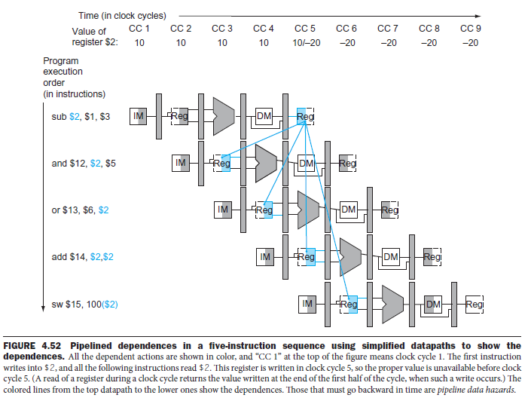

Slide 22
Forwarding
Consider sub and and
result is available at the end of the EX stage or clock cycle 3
When is the data actually needed by the AND and OR instructions?
At the beginning of the EX stage, or CC4 and CC5, respectively.
Thus, we can execute this segment without stalls if we simply forward the data as soon as it is available to any units that need it before it is available to read from the register file
How does forwarding work?
For simplicity, consider forwarding to an operation in the EX stage, which may be either an ALU operation or an effective address calculation
So, forwarding means that
when an instruction tries to use a register in its EX stage that an earlier instruction intends to write in its WB stage, we actually avail the values as inputs to the ALU

Slide 23
hazard conditions : dependence detection
We call a data dependence a hazard when an instruction tries to read a register in stage 2 (ID) and this register will be written by a previous instruction that has not yet completed stage 5 (WB) → RAW
Rd
Rs
Op
Rt
1a. ID/EX.RegisterRs == EX/MEM.RegisterRd
1b. ID/EX.RegisterRt == EX/MEM.RegisterRd
2a. ID/EX.RegisterRs == MEM/WB.RegisterRd
2b. ID/EX.RegisterRt == MEM/WB.RegisterRd

Slide 24
hazard conditions : dependence detection
1a. ID/EX.RegisterRs == EX/MEM.RegisterRd
1b. ID/EX.RegisterRt == EX/MEM.RegisterRd
2a. ID/EX.RegisterRs == MEM/WB.RegisterRd
2b. ID/EX.RegisterRt == MEM/WB.RegisterRd
sub $2, $1,$3
and $12,$2,$5
or $13,$6,$2
add $14,$2,$2
sw $15,100($2)
sub $2,$1,$3
and $12,$2,$5.
EX/MEM.RegisterRd = ID/EX.RegisterRs = $2
sub $2, $1, $3
or $13, $6, $2
MEM/WB.RegisterRd = ID/EX.RegisterRt = $2
sub - add
not hazards
sub - sw
not hazards

Slide 25
Detecting hazards and applying stalls to resolve
Between instruction i+1 and instruction i (3 bubbles):
ID/EX.WriteReg == IF/ID read-register 1 or 2
Between instruction i+2 and i (2 bubbles):
EX/MEM.WriteReg == IF/ID read-register 1 or 2
Between instruction i+3 and i (1 bubble):
MEM/WB.WriteReg == IF/ID read-register 1 or 2
Note that stalls stop instructions in the ID stage
Therefore, we must stop fetching new instructions, or else we would clobber the PC and the IF/ID register.
So, we need control lines to:
Create bubbles. This can be done by setting all control lines that are passed from ID to 0, hence creating a nop.
Prevent new instruction fetches. This should be done for as many cycles as there are bubbles.

Slide 26
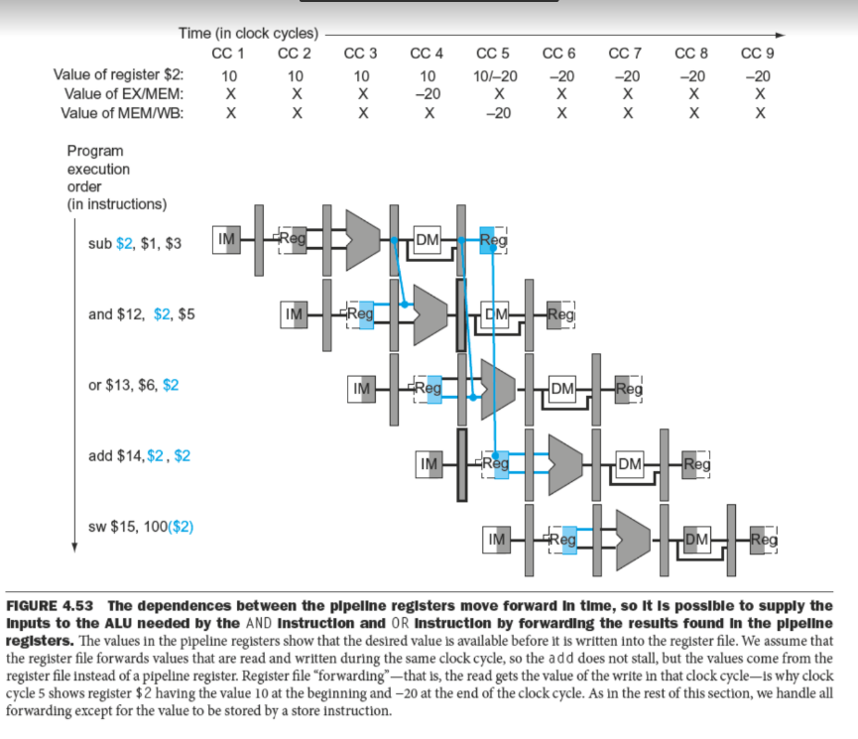
Forwarding is sometimes called
bypassing.

Slide 27
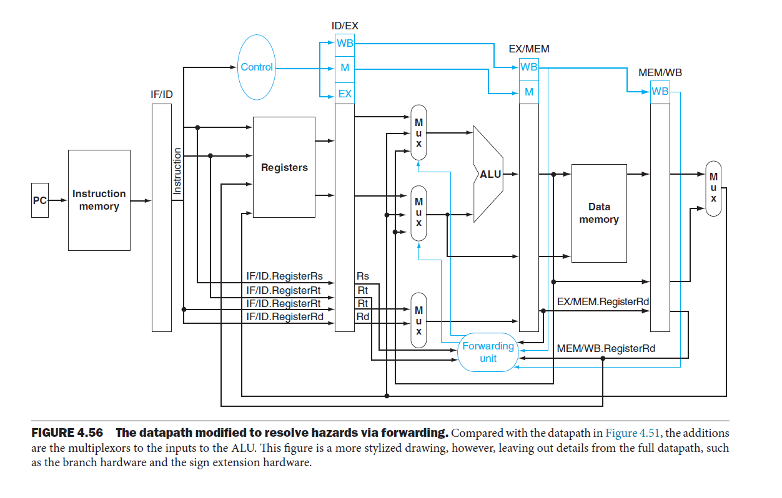
the hardware necessary to support forwarding
EX/MEM.RegisterRd field is the register destination for either an ALU instruction (which comes from the Rd field of the instruction) or a load (which comes from the Rt field)

Slide 28
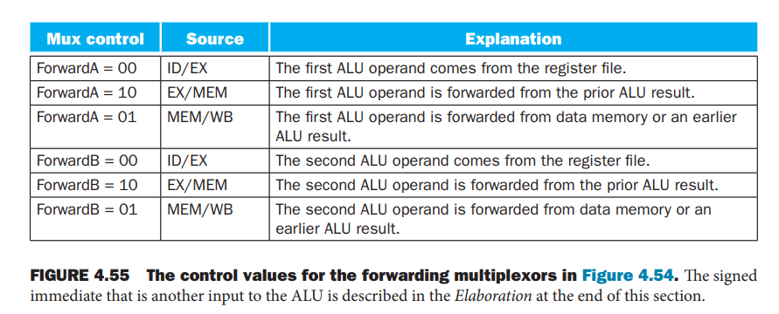
Forwarding Types
Forward First Operand
Forward Second Operand

Slide 29
Condition of data hazards
EX hazard:
if (EX/MEM.RegWrite and (EX/MEM.RegisterRd ≠ 0) and (EX/MEM.RegisterRd = ID/EX.RegisterRs))
ForwardA = 10
if (EX/MEM.RegWrite and (EX/MEM.RegisterRd ≠ 0) and (EX/MEM.RegisterRd = ID/EX.RegisterRt))
ForwardB = 10
MEM hazard:
if (MEM/WB.RegWrite and (MEM/WB.RegisterRd ≠ 0) and ( MEM/WB.RegisterRd = ID/EX.RegisterRs))
ForwardA = 01
if (MEM/WB.RegWrite and (MEM/WB.RegisterRd ≠ 0) and (MEM/WB.RegisterRd = ID/EX.RegisterRt))
ForwardB = 01
How about summing a vector of numbers in a single register, a sequence of instructions will all read and write to the same register?
the control for the MEM hazard would be
if (MEM/WB.RegWrite and (MEM/WB.RegisterRd ≠ 0) and not(EX/MEM.RegWrite and (EX/MEM.RegisterRd ≠ 0) and (EX/MEM.RegisterRd ≠ ID/EX.RegisterRs)) and (MEM/WB.RegisterRd = ID/EX.RegisterRs))
ForwardA = 01
if (MEM/WB.RegWrite and (MEM/WB.RegisterRd ≠ 0) and not(EX/MEM.RegWrite and (EX/MEM.RegisterRd ≠ 0) and (EX/MEM.RegisterRd ≠ ID/EX.RegisterRt)) and (MEM/WB.RegisterRd = ID/EX.RegisterRt))
ForwardB = 01

Slide 30
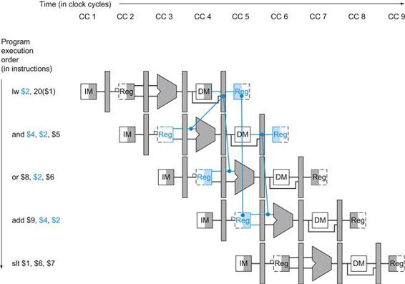
Can all data hazards be resolved by forwarding?
A bubble is inserted beginning in clock cycle 4, by changing the
and instruction to a nop.
Note that the “and” instruction is really fetched and decoded in clock cycles 2 and 3, but its EX stage is delayed until
clock cycle 5 (versus the unstalled position in clock cycle 4). Likewise the OR instruction is fetched in clock cycle 3, but its ID stage is delayed until clock cycle 5 (versus the unstalled clock cycle 4 position). After insertion of the bubble, all the dependences go forward in time and no further hazards occur.

Slide 31
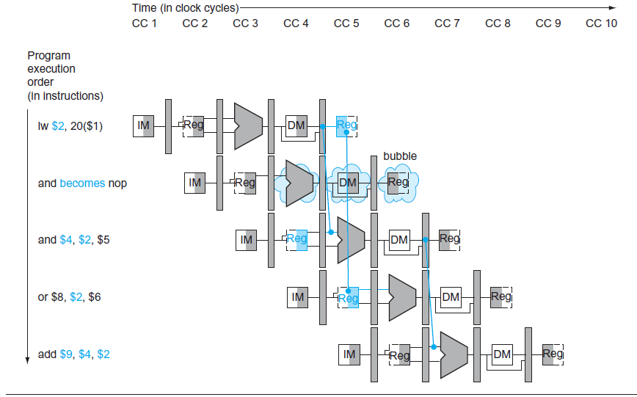
After stall

Slide 32
Control Hazards

Slide 33
Control Hazards
Pipeline hazards involving branches
An instruction must be fetched at every clock cycle to sustain the pipeline,
yet in our design the decision about whether to branch doesn’t occur until the MEM pipeline stage

Slide 34
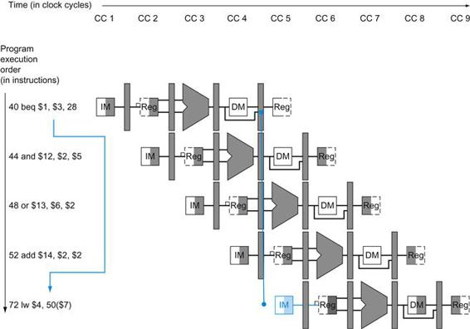
Control hazard

Slide 35
Solution to control hazards
We look at two schemes for resolving control hazards
one optimization to improve these schemes
Assume Branch Not Taken
stalling until the branch is complete is too slow
One improvement over branch stalling is to predict that the branch will not be taken and thus continue execution down the sequential instruction stream
If the branch is taken, the instructions that are being fetched and decoded must be discarded
Execution continues at the branch target
If branches are untaken half the time, and if it costs little to discard the instructions, this optimization halves the cost of control hazards

Slide 36
Solution to Control Hazards
Reducing the Delay of Branches
One way to improve branch performance is to reduce the cost of the taken branch
Thus far, we have assumed the next PC for a branch is selected in the MEM stage, but if we move the branch execution earlier in the pipeline, then fewer instructions need be flushed
The MIPS architecture was designed to support fast single-cycle branches that could be pipelined with a small branch penalty
Moving the branch decision up requires two actions to occur earlier:
Computing the branch target address and
Evaluating the branch decision.
The easy part of this change is to move up the branch address calculation.
We already have the PC value and the immediate field in the IF/ID pipeline register
So, we just move the branch adder from the EX stage to the ID stage;
of course, the branch target address calculation will be performed for all instructions, but only used when needed

Slide 37
The branch decision
For branch equal,
we would compare the two registers read during the ID stage to see if they are equal.
Moving the branch test to the ID stage implies additional forwarding and hazard detection hardware,
For example, to implement branch on equal (and its inverse), we will need to forward results to the equality test logic that operates during ID.
There are two complicating factors:
1. During ID, we must decode the instruction, decide whether a bypass to the equality unit is needed, and complete the equality comparison so that if the instruction is a branch, we can set the PC to the branch target address.
Forwarding for the operands of branches was formerly handled by the ALU forwarding logic, but the introduction of the equality test unit in ID will require new forwarding logic.
2. Because the values in a branch comparison are needed during ID but may be produced later in time, it is possible that a data hazard can occur and a stall will be needed.
For example, if an ALU instruction immediately preceding a branch produces one of the operands for the comparison in the branch, a stall will be required,
since the EX stage for the ALU instruction will occur after the ID cycle of the branch.
By extension, if a load is immediately followed by a conditional branch that is on the load result, two stall cycles will be needed,
as the result from the load appears at the end of the MEM cycle but is needed at the beginning of ID for the branch.

Slide 38
Example
Show what happens when the branch is taken in this instruction sequence, assuming the pipeline is optimized for branches that are not taken and that we moved the branch execution to the ID stage:
36 sub $10, $4, $8
40 beq $1, $3, 7 # PC-relative branch to 40 + 4 + 7 * 4 = 72
44 and $12, $2, $5
48 or $13, $2, $6
52 add $14, $4, $2
56 slt $15, $6, $7
. . .
72 lw $4, 50($7)
only one pipeline bubble on a taken branch

Slide 39
Dynamic Branch Prediction

Slide 40
Dynamic Branch Prediction
With more hardware, it is possible to try to predict branch behavior during program execution
One approach is to look up the address of the instruction to see if a branch was taken the last time this instruction was executed,
if taken, begin fetching new instructions from the same place as the last time
This technique is called dynamic branch prediction
One implementation of that approach is a branch prediction buffer or branch history table.
Branch prediction buffer : a small memory indexed by the lower portion of the address of the branch instruction
The memory contains a bit that says whether the branch was recently taken or not

Slide 41
1-bit prediction scheme
Consider a loop branch that branches nine times in a row, then is not taken once
What is the prediction accuracy for this branch, assuming the prediction bit for this branch remains in the prediction buffer?
Ans.
The steady-state prediction behavior will mispredict on the first and last loop iterations
Mispredicting the last iteration is inevitable since the prediction bit will indicate taken, as the branch has been taken nine times in a row at that point
The misprediction on the first iteration happens because the bit is flipped on prior execution of the last iteration of the loop, since the branch was not taken on that exiting iteration
Thus, the prediction accuracy for this branch that is taken 90% of the time is only 80% (two incorrect predictions and eight correct ones)

Slide 42
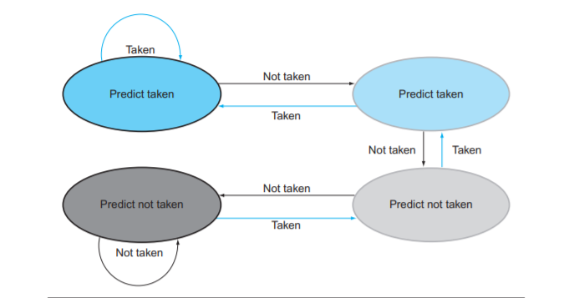
1-bit prediction scheme
Ideally, the accuracy of the predictor would match the taken branch frequency for these highly regular branches
It may not be suitable everywhere
To remedy this weakness, 2-bit prediction schemes are often used.
In a 2-bit scheme, a prediction must be wrong twice before it is changed.

Slide 43
Delayed Branch
A technique for minimizing the effect of control dependencies is to separate the point where the branch operation takes effect from the branch tests.
The branch instruction performs a test on a branch condition.
If the test succeeds, the PC is modified, but the modification does not take effect immediately.
This delayed branch allows one or more instructions following the branch to be executed in the pipeline whether the branch is taken or not.
In the MIPS CPU, the branch operation is delayed by one instruction.
The MAL assembler hides the delayed branch by inserting an instruction after each branch or jump.
The instruction slot following a branch or jump is called the delay slot.
By default the assembler inserts an instruction which does nothing, a no-op.
The PC was incremented when the branch was fetched and therefore the branch offset is relative to the instruction after the branch.
The delayed branch means that the instruction following the branch is always executed before the PC is modified to perform the branch.

Slide 44
branch delay slot
The slot directly after a delayed branch instruction, which in the MIPS architecture is filled by an instruction that does not affect the branch.
A delayed branch always executes the following instruction, but the second instruction following the branch will be affected by the branch.
Compilers and assemblers try to place an instruction that always executes after the branch in the branch delay slot
The job of the software is to make the successor instructions valid and useful.
Example 1
LOOP: LW R1, 0(R2) SUB R3, R3, R1 BNEZ R3 LOOP SW R4, 0(R3)
the value of R3 is changing in the loop, hence “sw …” not possible to execute

Slide 45
branch delay slot
The slot directly after a delayed branch instruction, which in the MIPS architecture is filled by an instruction that does not affect the branch.
A delayed branch always executes the following instruction, but the second instruction following the branch will be affected by the branch.
Compilers and assemblers try to place an instruction that always executes after the branch in the branch delay slot
The job of the software is to make the successor instructions valid and useful.
Example 1
Example 2
LOOP: LW R1, 0(R2) SUB R3, R3, R1 BNEZ R3 LOOP SW R4, 0(R3)
the value of R3 is changing in the loop, hence “sw …” not possible to execute
But, suppose instead we had the instruction “SW R3, 0(R4)” following the BNEZ instruction
LOOP: LW R1, 0(R2) SUB R3, R3, R1 BNEZ R3 LOOP SW R3, 0(R4)

Slide 46
branch delay slot
The slot directly after a delayed branch instruction, which in the MIPS architecture is filled by an instruction that does not affect the branch.
A delayed branch always executes the following instruction, but the second instruction following the branch will be affected by the branch.
Compilers and assemblers try to place an instruction that always executes after the branch in the branch delay slot
The job of the software is to make the successor instructions valid and useful.
Example 1
Example 2
LOOP: LW R1, 0(R2) SUB R3, R3, R1 BNEZ R3 LOOP SW R4, 0(R3)
the value of R3 is changing in the loop, hence “sw …” not possible to execute
But, suppose instead we had the instruction “SW R3, 0(R4)” following the BNEZ instruction
LOOP: LW R1, 0(R2) SUB R3, R3, R1 BNEZ R3 LOOP SW R3, 0(R4)
still wasting a cycle for each time we DO go through the loop

Slide 47
branch delay slot
The slot directly after a delayed branch instruction, which in the MIPS architecture is filled by an instruction that does not affect the branch.
A delayed branch always executes the following instruction, but the second instruction following the branch will be affected by the branch.
Compilers and assemblers try to place an instruction that always executes after the branch in the branch delay slot
The job of the software is to make the successor instructions valid and useful.
Example 1
Example 2
LOOP: LW R1, 0(R2) SUB R3, R3, R1 BNEZ R3 LOOP SW R4, 0(R3)
the value of R3 is changing in the loop, hence “sw …” not possible to execute
But, suppose instead we had the instruction “SW R3, 0(R4)” following the BNEZ instruction
LOOP: LW R1, 0(R2) SUB R3, R3, R1 BNEZ R3 LOOP SW R3, 0(R4)
Example 3
LOOP: SUB R3, R3, R1
SW R3, 0(R5)
BNEZ R3 LOOP
SW R4, 0(R6)
find an instruction either from inside the loop, or from before the loop, that can safely be rescheduled
still wasting a cycle for each time we DO go through the loop

Slide 48
branch delay slot
The slot directly after a delayed branch instruction, which in the MIPS architecture is filled by an instruction that does not affect the branch.
A delayed branch always executes the following instruction, but the second instruction following the branch will be affected by the branch.
Compilers and assemblers try to place an instruction that always executes after the branch in the branch delay slot
The job of the software is to make the successor instructions valid and useful.
Example 1
Example 2
LOOP: LW R1, 0(R2) SUB R3, R3, R1 BNEZ R3 LOOP SW R4, 0(R3)
the value of R3 is changing in the loop, hence “sw …” not possible to execute
But, suppose instead we had the instruction “SW R3, 0(R4)” following the BNEZ instruction
LOOP: LW R1, 0(R2) SUB R3, R3, R1 BNEZ R3 LOOP SW R3, 0(R4)
Example 3
the final result will not be altered even if branch is taken
LOOP: SUB R3, R3, R1
SW R3, 0(R5)
BNEZ R3 LOOP
SW R4, 0(R6)
find an instruction either from inside the loop, or from before the loop, that can safely be rescheduled
still wasting a cycle for each time we DO go through the loop
move SW R3, 0(R5) right after BNEZ

Slide 49
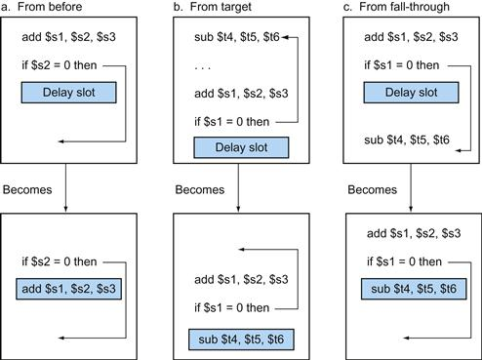
branch delay slot
Delayed branching was a simple and effective solution for a five-stage pipeline issuing one instruction each clock cycle
As processors go to both longer pipelines and issuing multiple instructions per clock cycle, the branch delay becomes longer, and a single delay slot is insufficient

Slide 50
branch delay slot
three strategies for scheduling the branch delay slot
(a) the delay slot is scheduled with an independent instruction from before the branch
This is the best choice.
Strategies (b) and (c) are used when (a) is not possible.
In the code sequences for (b) and (c),
the use of $s1 in the branch condition prevents the add instruction (whose destination is $s1) from being moved into the branch delay slot
In (b) the branch delay slot is scheduled from the target of the branch;
usually the target instruction will need to be copied because it can be reached by another path
Strategy (b) is preferred when the branch is taken with high probability, such as a loop branch.
Finally, the branch may be scheduled from the not-taken fall-through as in (c)
To make this optimization legal for (b) or (c), it must be OK to execute the sub instruction when the branch goes in the unexpected direction.
By “OK” we mean that the work is wasted, but the program will still execute correctly
This is the case, for example, if $t4 were an unused temporary register when the branch goes in the unexpected direction

Slide 51
LOOP: SUB R3, R3, R1
BNEZ R3 LOOP
SW R3, 0(R5)
SW R4, 0(R6)
go through the loop twice
 | 1 | 2 | 3 | 4 | 5 | 6 | 7 | 8 | 9 | 10 | 11 | 12 | 13 | 14 | 15 | 16 | 17
SUB R3,R3,R1 | IF | ID | EX | Mem | WB
BNEZ R3,Loop |  | IF | ID | EX | Mem | WB
SW R3, 0(R5) |  |  | IF | ID | EX | Mem | WB
SUB R3,R3,R1 |  |  |  | IF | ID | EX | Mem | WB
BNEZ R3,Loop |  |  |  |  | IF | ID | EX | Mem | WB
SW R3, 0(R5) |  |  |  |  |  | IF | ID | EX | Mem | WB
SW R4, 0(R6) |  |  |  |  |  |  | IF | ID | EX | Mem | WB

Slide 52


